Slide 1

Developing a Chaos Architecture Mindset
?
Adrian Cockcroft
@adrianco
AWS VP Cloud Architecture Strategy

Slide 2
As an architect my role wasn’t to tell other people what the architecture should be.
It was to ask awkward questions…

Slide 3
What problem are you trying to solve?
HINT—Building or installing a framework is the wrong answer…
Something involving users or business needs is a good answer.
—Reynold Jabbour

Slide 4

What is the user need?
What problem are you trying to solve?
—Reynold Jabbour
User need

Slide 5

User need
What is the user need?
What does the value chain look like?
What’s your time-to-value?
How is the value chain evolving?
Have you heard of Simon Wardley?

Slide 6
Leverage
Wardley Maps
Visualize evolution and innovate further up the value chain
Notes:
New Needs: IoT, analytics, social media monitoring, scale with number of interactions times number of products shipped, predictive modeling

Slide 7
Let’s look at your
Wardley Map
What’s your position and movement on the map?
Notes:
New Needs: IoT, analytics, social media monitoring, scale with number of interactions times number of products shipped, predictive modeling

Slide 8
What should your system do when something fails?
Stop?
Carry on with reduced functionality?

Slide 9
Permissive failure, what’s the real cost of continuing?
What should IT do when something fails?
If a permissions look up fails, should you stop or continue?
See Memories, Guesses, and Apologies by Pat Helland

Slide 10
How often do you failover apps to it?
If a permissions look up fails, should you stop or continue?
Do you have a backup datacenter?
How often do you failover the whole datacenter at once?
“Availability Theater”

Slide 11
A fairy tale…
Once upon a time, in theory, if everything works perfectly, we have a plan to survive the disasters we thought of in advance.
How did that work out?

Slide 12
Forgot to renew domain name…
SaaS vendor
Entertainment site
Didn’t update security certificate and it expired…
Datacenter flooded in hurricane Sandy…
Finance company, Jersey City
Whoops!
YOU, tomorrow

Slide 13
“You can’t legislate against failure, focus on fast detection and response.”
—Chris Pinkham

Slide 14
Are processes and roles documented?
Do you have a defined architecture?
Are documents up to date?
Do people follow the documented process?
Is the architecture implemented as designed?

Slide 15
Authoritarian High Modernism Workers should do what they’re told
How do you try to make people comply with your architecture?
Do you have a defined architecture?
Taylorism
Management as an exact science

Slide 16

Synoptic Illegibility
If you can’t write down exactly what really happens, you can’t write a synopsis and the architecture is ad-hoc and messy
The Safety Anarchist Sydney Decker

Slide 17
What is supposed to happen when part of the system fails?
How do you know that your system works at all?
How is it supposed to recover after the failure goes away?

Slide 18

The Network Is Reliable ACM Queue 2014
Bailiss & Kingsbury
@pbailiss @aphyr

Slide 19
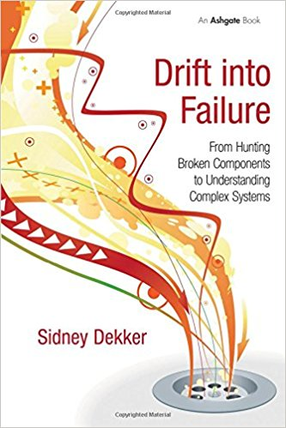
Drift Into Failure
Sydney Dekker

Slide 20
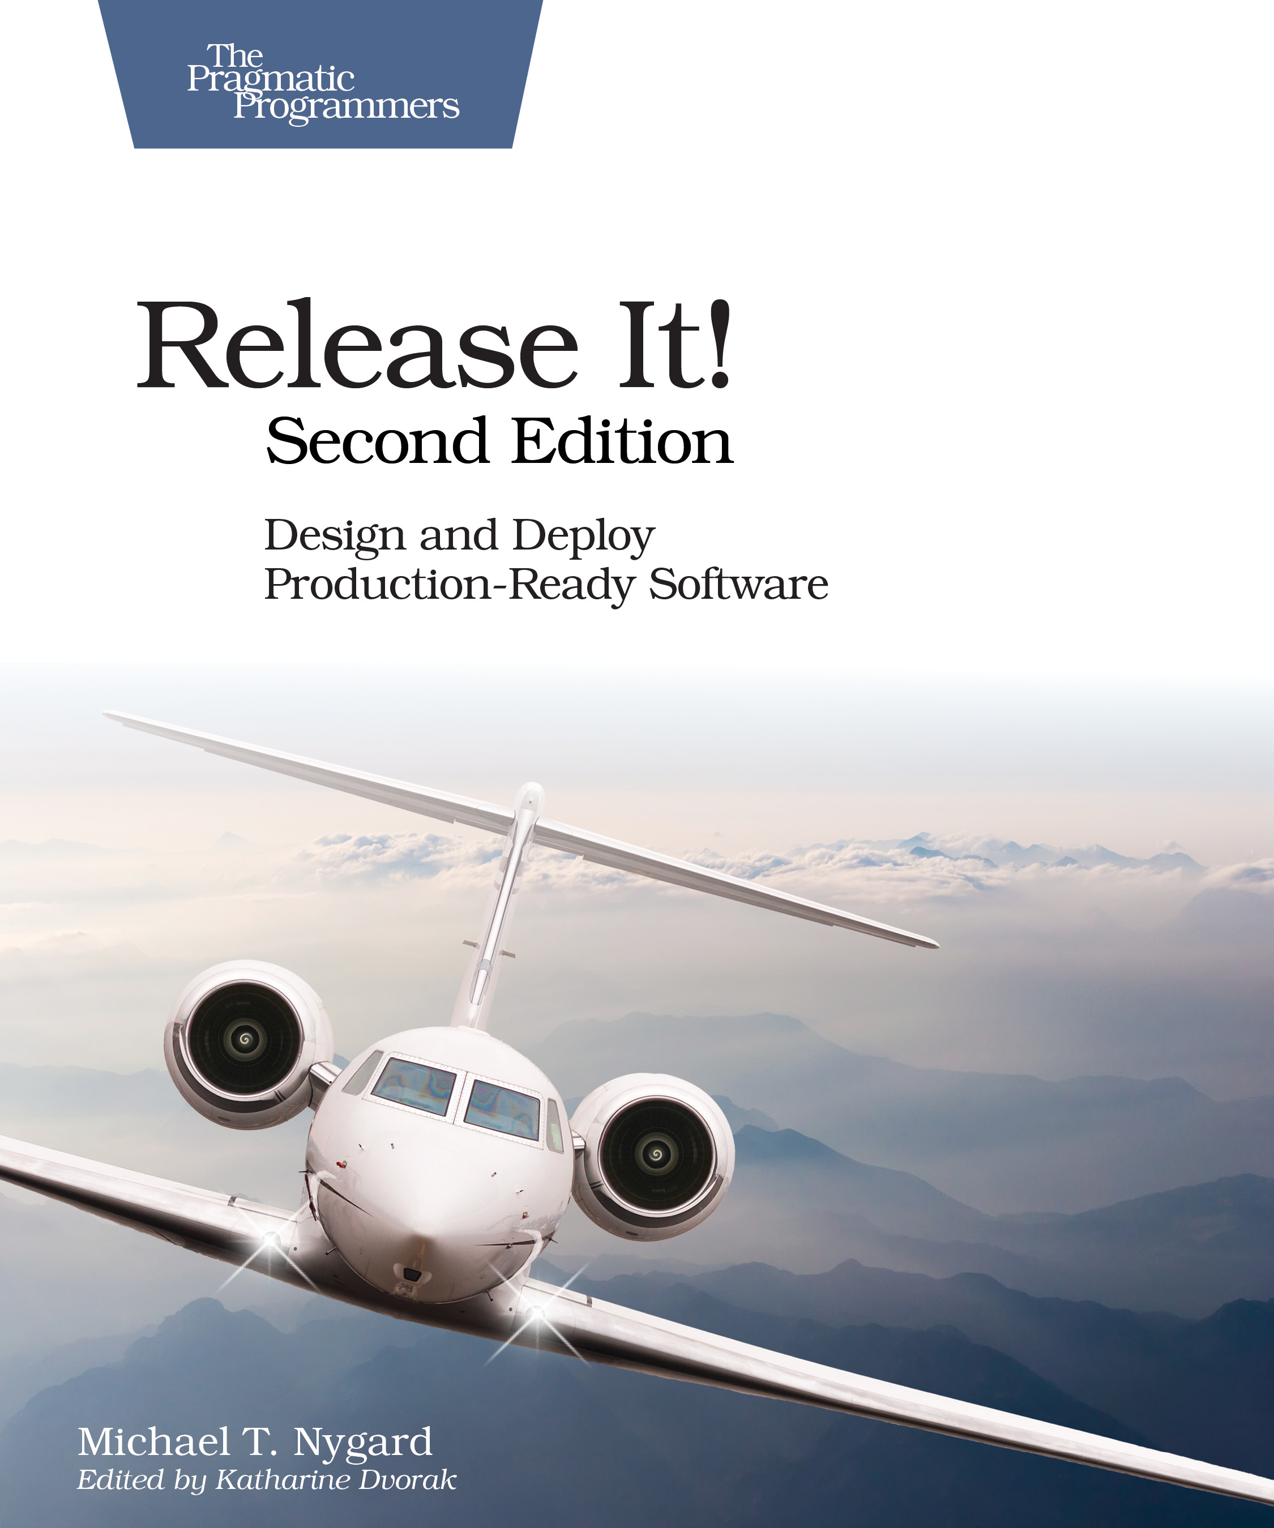
Release It! Second Edition 2017
Michael Nygard

Slide 21
Chaos Architecture
A Cloud Native Availability Model
Adrian Cockcroft

Slide 22
Chaos Architecture
Four layers
Two teams
An attitude

Slide 24
Infrastructure and Services
No single point of failure

Slide 25
Infrastructure

Slide 27

Switching and Interconnecting
Data replication
Traffic routing
Avoiding issues
Anti-entropy recovery

Slide 28
Switching and Interconnecting
Data replication
Traffic routing
Avoiding issues
Anti-entropy recovery

Slide 29
Switching and Interconnecting
Data replication
Traffic routing
Avoiding issues
Anti-entropy recovery

Slide 30
Switching
Infrastructure

Slide 32
!
Application
Failures
App
Error returns
Slow response
Network partition

Slide 33
Application
Switching
Infrastructure

Slide 35
People
Whoops!
I wonder why it did that?
Let’s reboot it.
Now it’s really hosed
Unexpected application behavior often causes people to intervene and make the situation worse

Slide 36
People Training
!
A fire drill is a boring routine where we make everyone take the stairs and assemble in the parking lot

Slide 37
People Training
Fire drills save lives in the event of a real fire, because people are trained how to react

Slide 38
People
Who runs the “fire drill” for I.T.?
Application
Switching
Infrastructure

Slide 39
People
Application
Chaos Engineering Team
Switching
Infrastructure

Slide 40
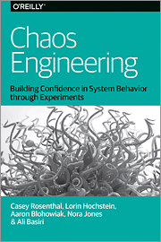
People
Application
Chaos Engineering Team
Switching
Infrastructure

Slide 41
People
Application
Tools
Chaos Engineering Team
Switching
Infrastructure

Slide 42


Tools
Game days
People
Simian Army
Application
chaostoolkit
Chaos Engineering Team
Switching
ChAP
Gremlin
Infrastructure

Slide 43
People
Application
Tools
Chaos Engineering Team
Switching
Security Red Team
Infrastructure

Slide 44
People
Application
Tools
Tools
Chaos Engineering Team
Switching
Security Red Team
Infrastructure

Slide 45
Tools
People
Safestack AVA
Application
Metasploit
Tools
Chaosslingr
Chaos Engineering Team
Switching
Security Red Team
AttackIQ
Infrastructure
SafeBreach

Slide 46
Chaos
Architecture
People
Application
Four layers
Two teams
An attitude— Break it to make it better
Tools
Tools
Chaos Engineering Team
Switching
Security Red Team
Infrastructure

Slide 47
Break it to make it safer
The “New View” of Safety based on:
Todd Conklin’s Pre-accident podcast
John Allspaw’s stella.report
Sydney Dekker—Drift into Failure

Slide 48
Failures are a system problem— lack of safety margin
Not something with a root cause of component or human error

Slide 49
Blindfolded on a cliff edge, what would you do?

Slide 50
Hypothesis testing
We think we have safety margin in this dimension, let’s carefully test to be sure
In production
Without causing an issue

Slide 51
Experienced Staff
Robust Applications
Dependable Switching Fabric
Redundant Service Foundation

Slide 52
Chaos Architecture
Ask the awkward questions
Adrian Cockcroft
@adrianco

